Slide 1
Wondering how to program the UHF RFID-labels with an RFID printer?
All these GS1 EPC ISO?
With Cleverence Wonderfid Printing it’s never been easier!
Just select what type of objects you are going to label and print!

Slide 2
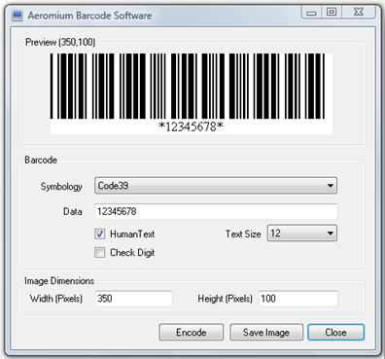
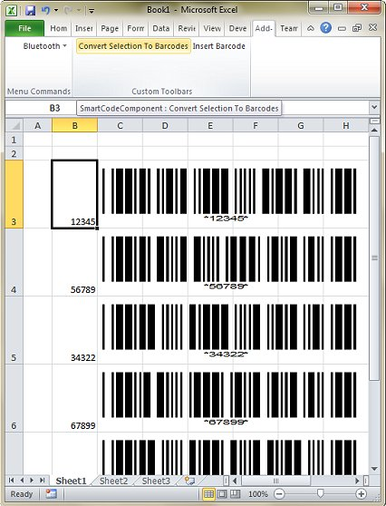
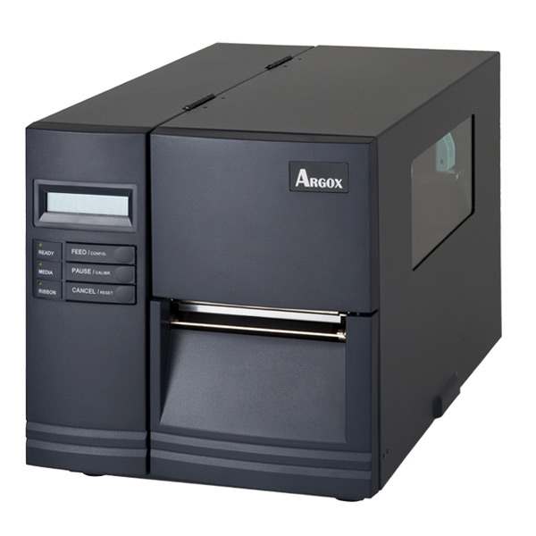
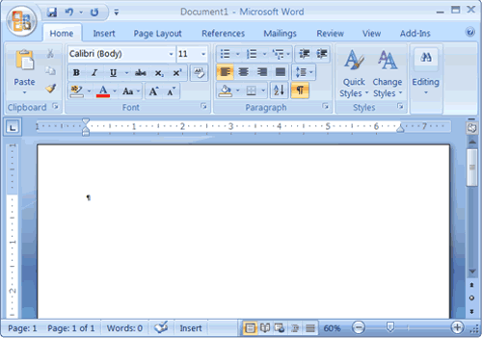
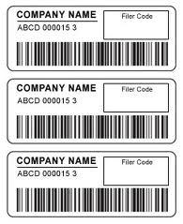
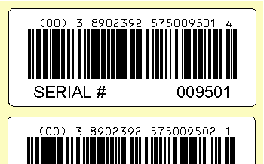
No more mind-boggling label designers!
No more cumbersome printer-specific languages!
Print anytime from everywhere!
Wonderfid!
Your Random App
RFID-encoded !!!

Slide 3
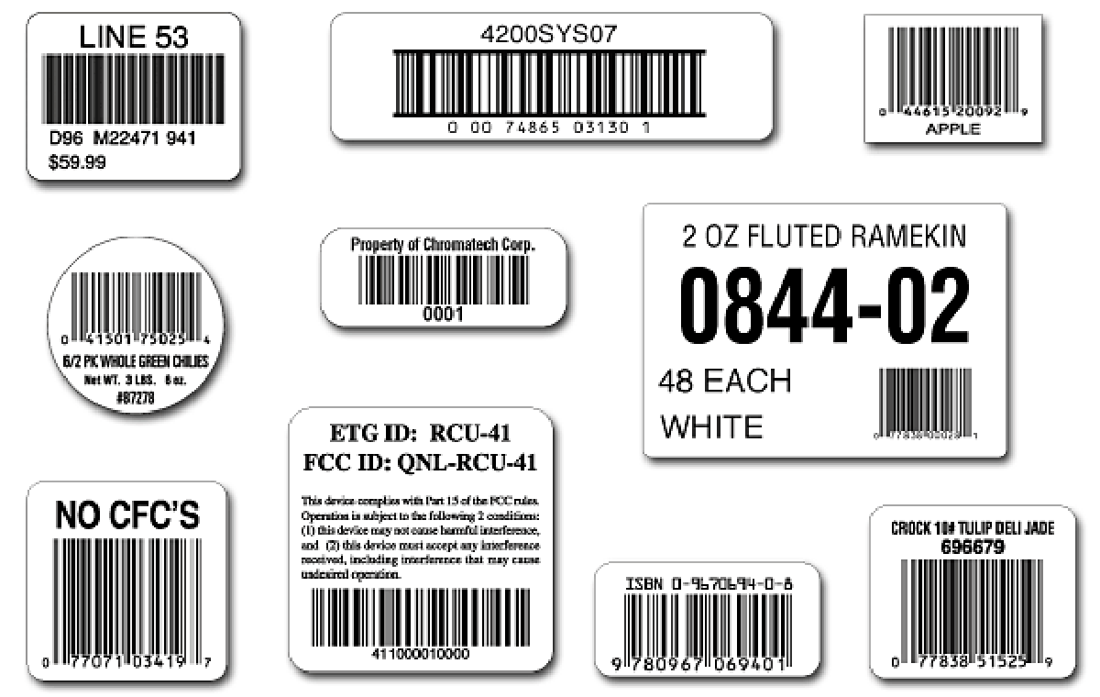
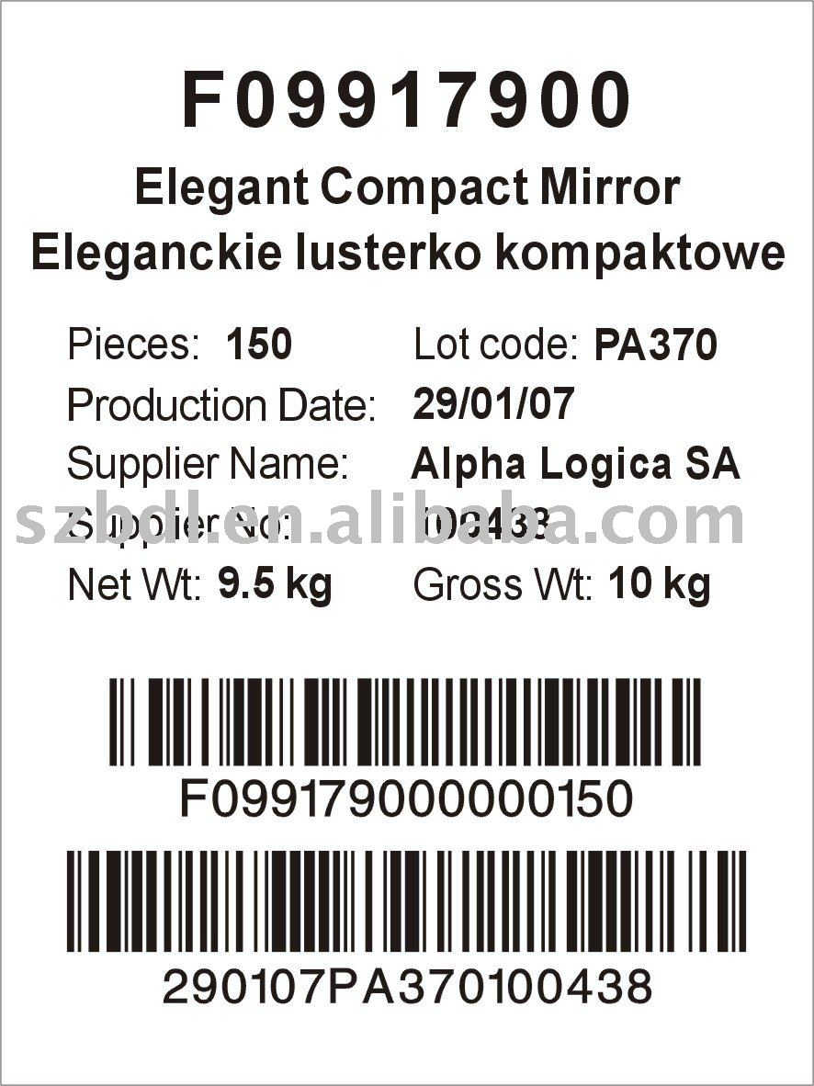
Wonderfid Printing technology recognizes all the data from your labels and tells the RFID-printer exactly what how then should be programmed onto the RFID-label

Slide 4
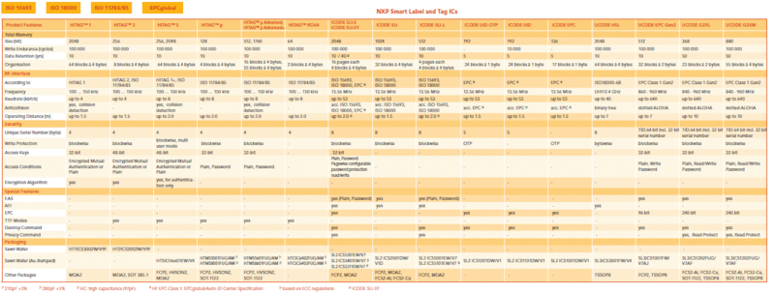
Wonderfid Printing even supports Multivendor Chip Serialization for Retail to ensure all your items are uniquely labeled

Slide 5
Finally, the RFID-solution for the rest of us
It’s so easy – you wouldn’t believe it

